Slide 1

Infosys Food Trends
INTERNSHIP 6.0
Exploring food choices to design smarter, sustainable dining solutions
Presented by:
Maithili Phulari (Group 3)

Slide 2
Project Overview
Group 3
The Smart Food Suggestion Dashboard aims to analyze food-related data and help users maintain balanced diets through meaningful insights.
Key Focus Areas :
Health Awareness: Understanding calorie and nutrient intake patterns.
Smart Suggestions: Providing meal recommendations based on lifestyle and dietary preferences.
Data Insights: Using Power BI to identify key food trends and health metrics.

Slide 3
Project Goals
Group 3
Explore Food & Beverage Trends : Study both global and Indian F&B developments to identify changing customer preferences and future opportunities.
Understand Dining Innovations : Analyze modern solutions in corporate and retail dining like digital ordering, AI menus, and sustainability practices.
Recommend Employee-Centric Solutions :Propose strategies that enhance food quality, accessibility, and satisfaction for Infosys employees.

Slide 4
Methodology
Group 3
Data Collection: Gathered dataset containing age, gender, dietary preference, calories, and nutrition details.
Data Cleaning & Processing: Removed duplicates, standardized data, and added new calculated columns.
Dashboard Design: Created visual insights showing calorie intake, nutrients, and meal recommendations.
Insights & Feedback: Derived key takeaways to help improve diet plans and awareness.

Slide 5
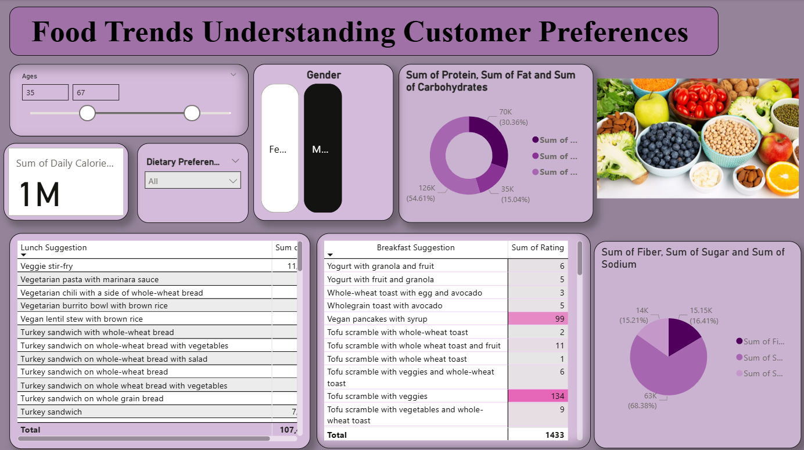
Dashboard 1
This dashboard provides an overall view of customers nutrition and meal preferences.
Displays total calorie targets across all users using KPI indicators.
Slicers for Age, Gender, Dietary Preference make insights more personalized.
Donut charts show the proportion of Protein, Fat, and Carbohydrates intake.
Another donut highlights the contribution of Fiber, Sugar, and Sodium in diets.
Lunch and breakfast suggestion tables display food options with ratings and prices.
Helps identify which meal combinations are both nutritious and affordable.
Reveals how eating preferences vary between males and females Assists in understanding the relationship between user demographics and meal choices.
Offers a foundation for exploring deeper insights on nutrition behavior.

Slide 6
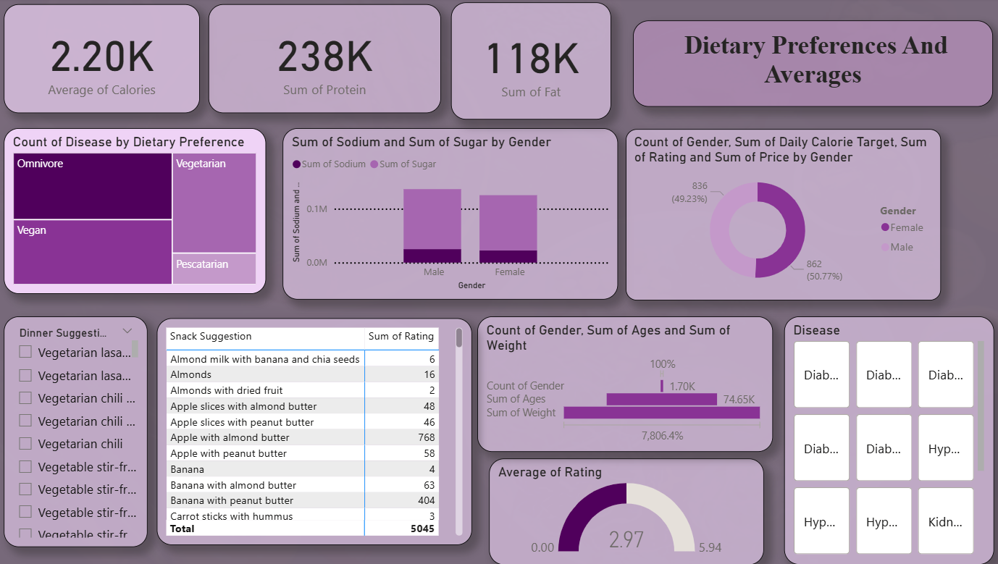
Dashboard 2
This dashboard focuses on comparing dietary groups such as Omnivore, Vegetarian, Vegan, and Pescatarian.
KPI cards summarize average calories, total protein, and total fat consumed.
The Tree Map shows disease distribution by diet type, identifying at-risk categories.
The donut chart compares gender distribution, showing balanced participation in data.
Scatter plot reveals the relationship between sodium and sugar levels for each disease.
Snack suggestion table shows the most popular and highly rated snack options.
Bar chart represents gender-wise distribution of age and weight, giving demographic depth.
Gauge chart visualizes average food rating, indicating satisfaction trends.
Highlights that vegetarians and vegans have slightly lower disease rates.
Useful for understanding how dietary habits influence nutrition balance and health outcomes.

Slide 7
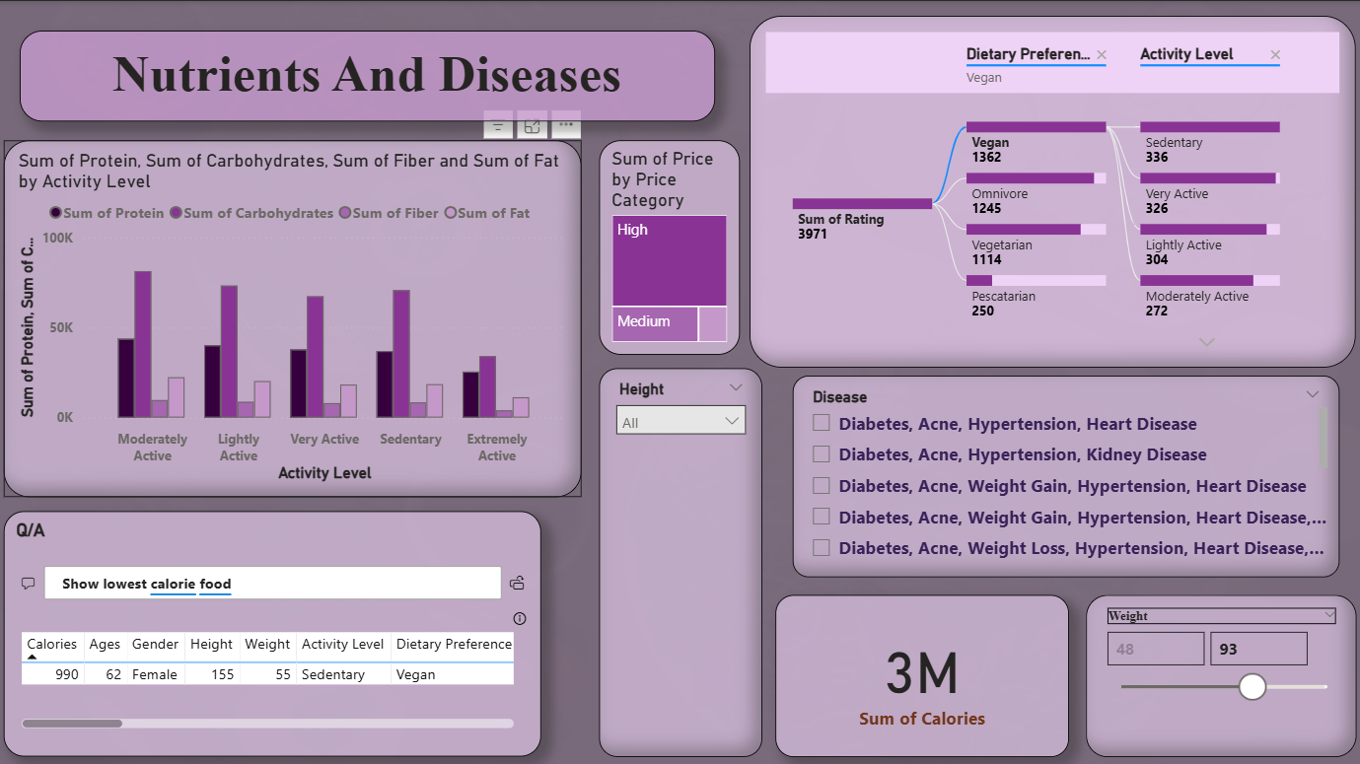
Dashboard 3
Examines how macronutrients (protein, carbs, fat, fiber)* relate to activity level and disease occurrence.
Clustered column chart compares nutrient consumption by activity level.
Tree Map visualizes total food price by price category, showing affordability distribution.
Bar chart links dietary preferences with activity patterns.
Table lists diseases such as Diabetes, Hypertension, Obesity, etc., for analysis.
Card visual displays the total calorie consumption across all users.
Weight and height slider filters allow dynamic exploration of body data.
Q/A box helps quickly identify lowest-calorie foods for specific conditions.
Highlights connection between poor diet and diseases like hypertension or obesity.
Enables better understanding of how lifestyle and nutrition impact overall wellness.

Slide 8
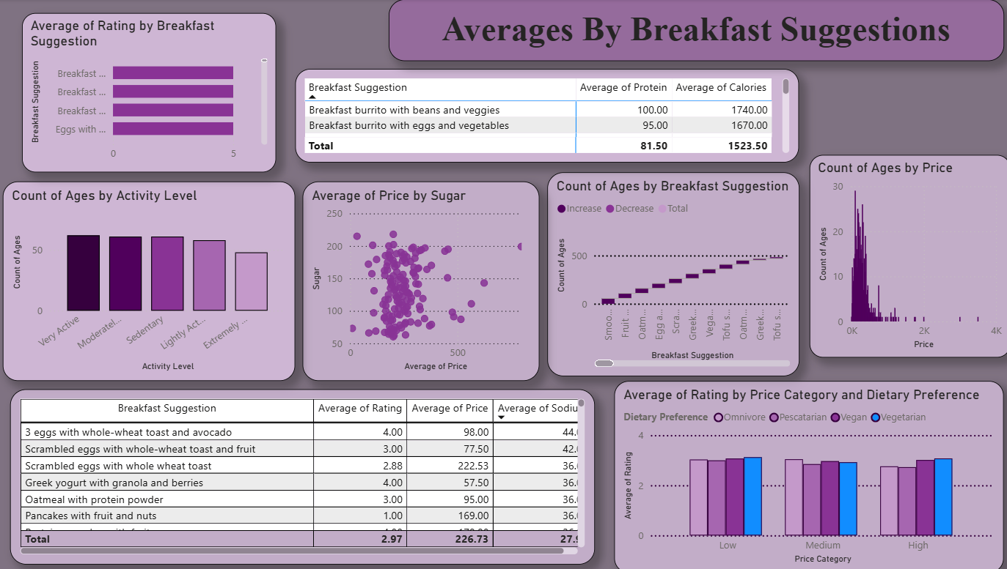
Dashboard 4
Focuses on breakfast food trends and their effect on ratings, nutrition, and cost.
Bar chart compares average ratings across different breakfast items.
Tables display nutrient averages (protein, calories, sodium) for each breakfast suggestion.
Scatter chart analyzes how price relates to sugar content, identifying healthier options.
Line chart shows age distribution by breakfast type, indicating preferences by generation.
Histogram tracks count of ages by price, showing spending habits.
Combined chart compares price category with dietary preference and average rating.
Reveals which foods are nutritious yet affordable and well-rated.
Highlights that moderately priced breakfast items score highest in satisfaction.
Helps food planners recommend balanced and cost-effective morning meals.

Slide 9
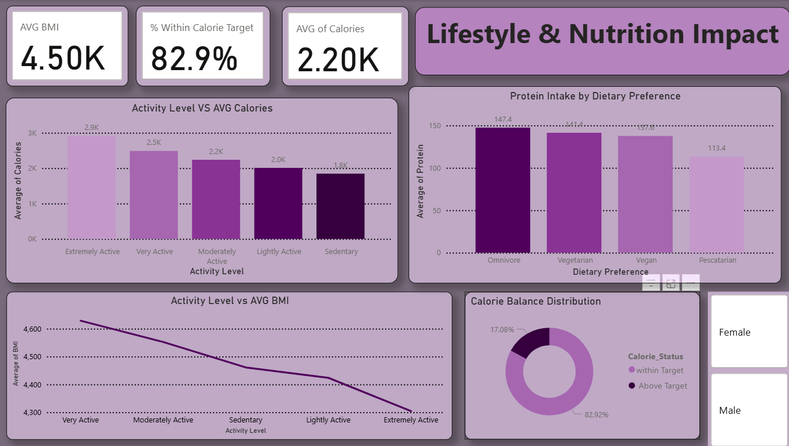
Dashboard 5
This dashboard connects lifestyle habits with nutritional outcomes.
KPI cards show Average BMI, % Within Calorie Target, and Average Calories.
Clustered column chart compares activity level vs. calorie intake showing higher calories for active people.
Line chart displays Activity Level vs. Average BMI, revealing how fitness level affects body index.
Donut chart splits calorie status into Within Target vs. Above Target categories. Column chart shows average protein intake across dietary preferences.
Gender slicer enables detailed comparison between males and females.
Reveals that very active individuals consume more calories but maintain healthy BMI levels.
Demonstrates link between balanced diet and meeting calorie goals.
Provides actionable insights for designing personalized fitness and diet plans.

Slide 10
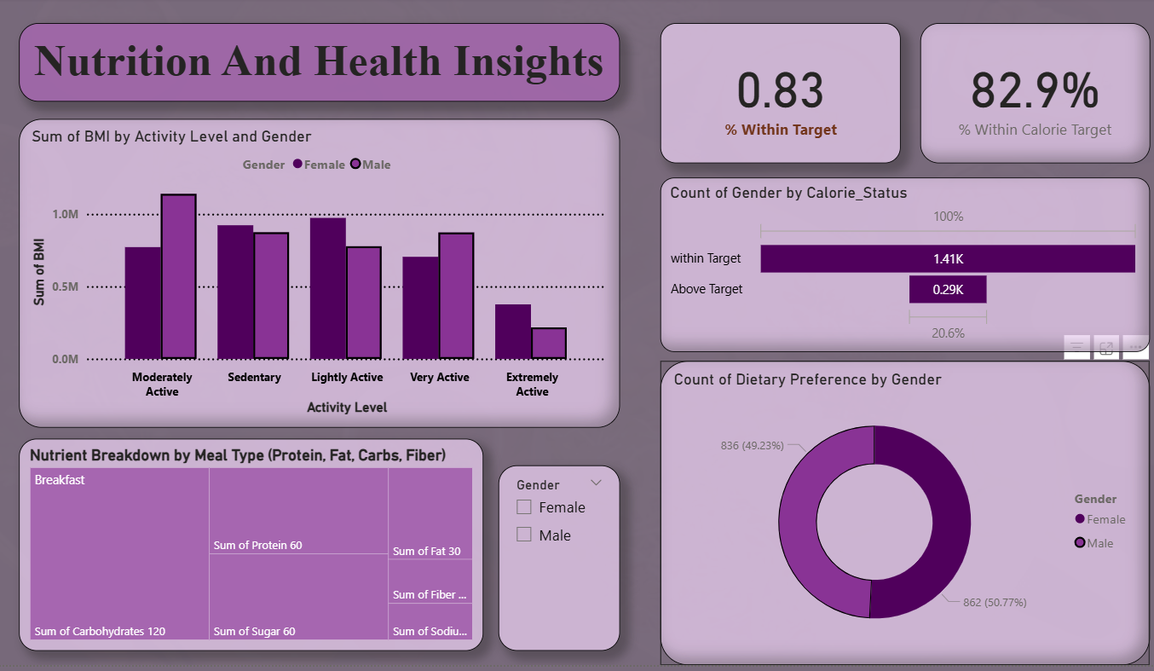
Dashboard 6
Highlights the connection between gender, activity level, and nutritional status.
Majority (82.9%) of participants stay within their calorie target, reflecting balanced diets.
BMI levels are highest among sedentary and lightly active groups, especially females.
Tree map visualizes nutrient distribution by meal type, with carbohydrates contributing the most.
Gender-wise calorie status shows females slightly outperform males in staying within calorie limits.
Donut chart indicates balanced gender distribution across dietary preferences (≈49% female, 51% male).
KPIs emphasize health consistency through calorie adherence and BMI management.
Insight supports linking activity level and meal composition to overall health outcomes.
Enables quick comparison of gender-based patterns in calorie control and nutrient intake.
Concludes that moderate activity and balanced meal types lead to healthier BMI scores.

Slide 11
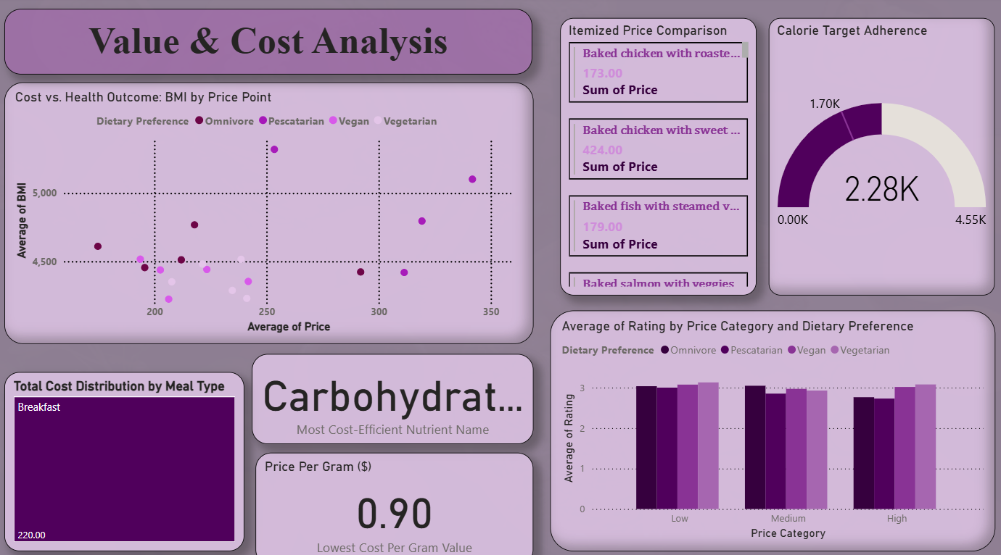
Dashboard 7
Focuses on understanding how food pricing impacts health outcomes and nutrient efficiency.
Scatter chart shows relationship between BMI and price, categorized by dietary type (omnivore, vegan, etc.).
Breakfast meals dominate total cost according to the treemap .
Carbohydrate identified as the most cost-efficient nutrient, balancing price and energy contribution.
Price per gram metric (0.90) helps identify value-for-money foods.
Gauge chart tracks calorie adherence most users fall around 50% of their daily calorie goal.
Table lists specific food items and their corresponding total cost.
Comparison of ratings by price range shows customer satisfaction remains stable across low-to-high categories.
Overall, the dashboard links monetary value with nutrition quality and BMI trends.

Slide 12
Conclusion
Group 3
Our dashboard gives meaningful insights into food consumption and nutrition balance. It supports better awareness of calorie intake and promotes healthy eating habits. By integrating data visualization and analysis, it helps users make informed food choices and maintain a balanced diet.

Slide 13
Thank You

